Slide 1
DATA SCIENCE
PART TIME COURSE
Week 1 - Course Overview & Getting Started

Slide 2
AGENDA
Meet The Instructors
Meet Your Classmates
Instructor Philosophy
Content Philosophy
How To Succeed
Typical Class
Logistics
Course Project
Setting Up

Slide 3
GREG BAKER - INSTRUCTOR
ABOUT ME
Freelance consultant currently working with BigInsights and Queckt, previously at Google and CSIRO. His username is solresol because there are too many Greg Bakers in this world.
Freelance data scientist, previously working in the areas of fraud detection, insurance and web analytics. He provides analytics services for businesses ranging from startups to ASX100 listed companies
http://www.flickr.com/photos/michaelhooper/7876600000/
P∀

Slide 4

MATT GIBSON - TA
Data scientist at Rocketboots working with computer vision engineers on CCTV and security products. Previously did analytics on consumer, social and political data for small and medium enterprise. Fascinated by all kinds of datasets!

Slide 5
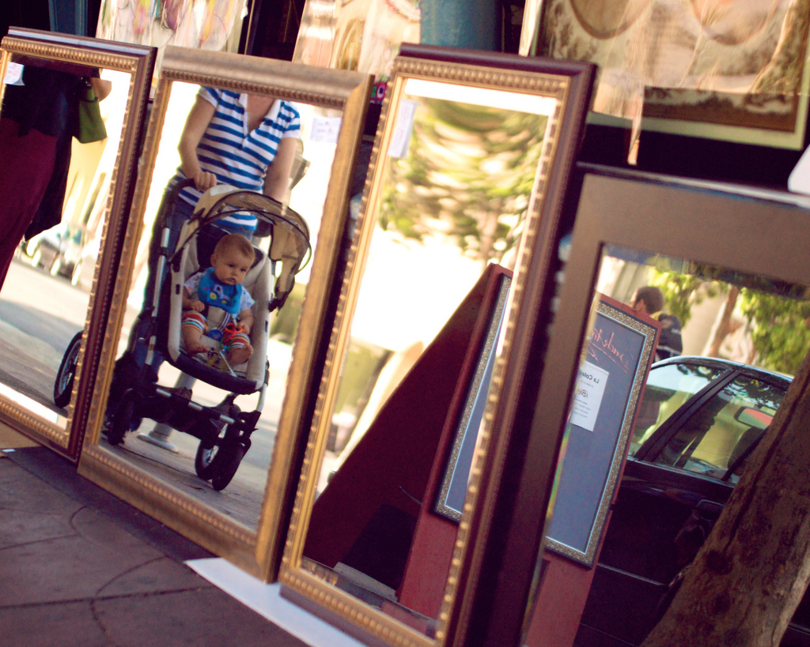
ABOUT YOU ?
ABOUT YOU
ABOUT ME
Who are you?
Why are you interested in Data Science?
Have you done anything with Python (or R)?
What is your exposure to Data Science so far?
Do you have any applications in mind?
http://www.flickr.com/photos/davefayram/3803310706

Slide 6
INSTRUCTOR PHILOSOPHY
Embrace Diversity
Seek an Optimal Pace
Communicate Early and Often
Success is not a grade, it’s an application

Slide 7

CONTENT PHILOSOPHY
Application-based Approach
Understand Key Principles
Balance Depth and Breadth
Course Project

Slide 8
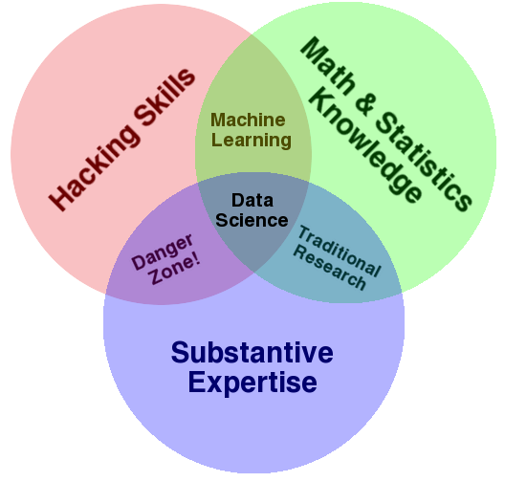
CONTENT PHILOSOPHY
Multidisciplinary Investigations
Models and Methods for Data
Computing with Data
Pedagogy
Tool Evaluation
Theory
Data Science: An Action Plan for Expanding the Technical Areas of the Field of Statistics
William S. Cleveland
Drew Conway’s
Data Science Venn Diagram

Slide 9
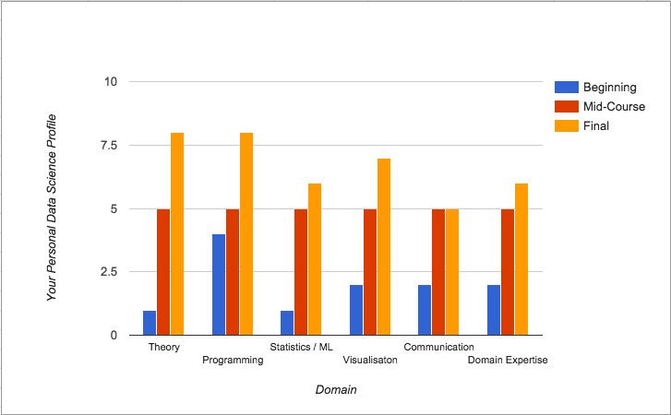
CONTENT PHILOSOPHY

Slide 10
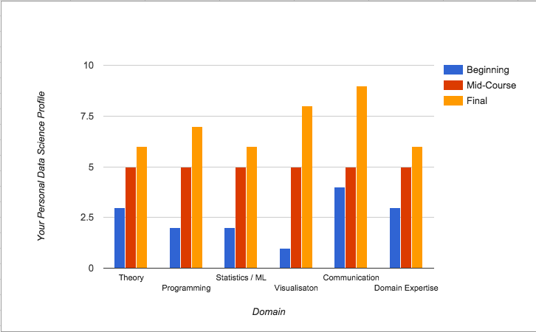
CONTENT PHILOSOPHY

Slide 11
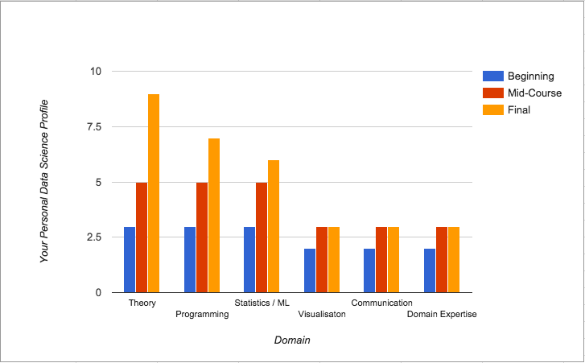
CONTENT PHILOSOPHY

Slide 12
CONTENT PHILOSOPHY

Slide 13
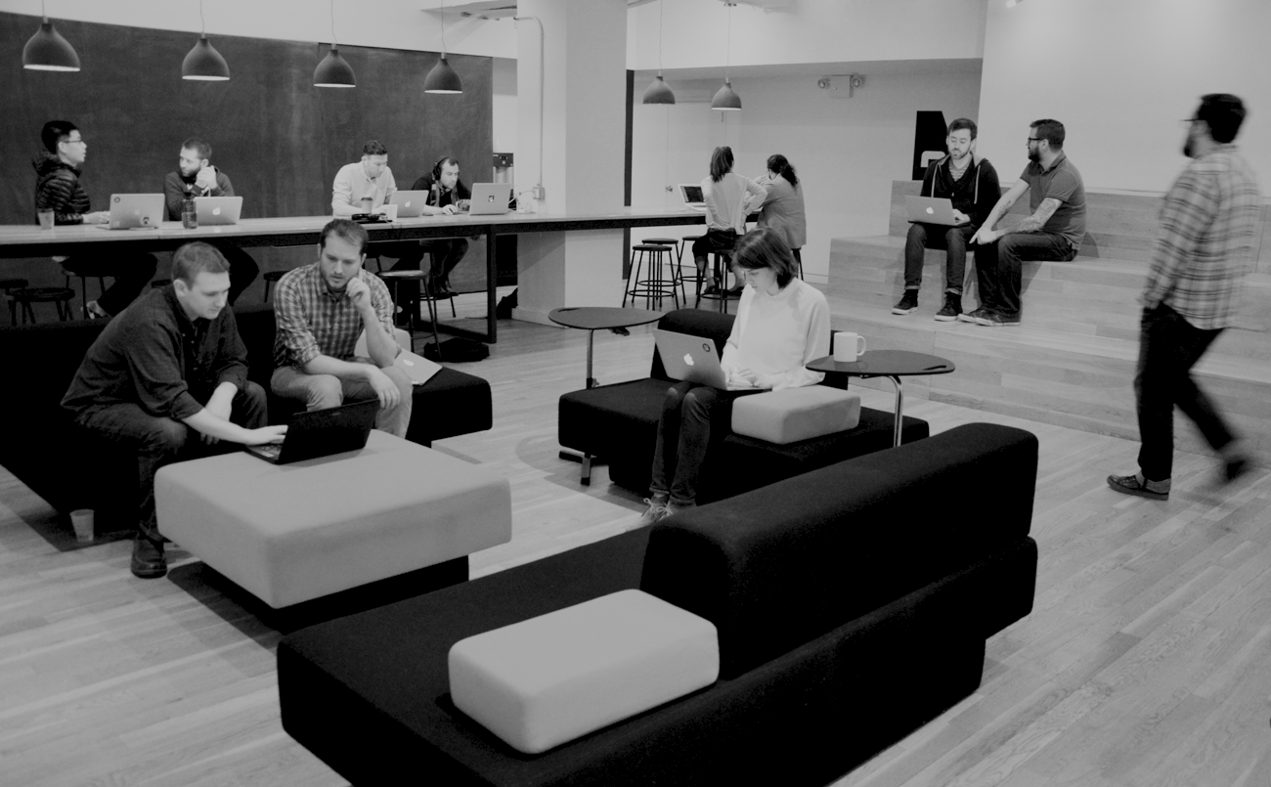
HOW TO SUCCEED
Effort not prior knowledge
Ask Questions
Communicate what you’ve learned
Help your Classmates
Be patient with yourself

Slide 14
TYPICAL CLASS
Guest Speaker (sometimes)
Overview of lesson objectives
Motivating Problem
Theory
Lab
Code Walk Through
Code Exercises
Class Discussion
Homework
Readings

Slide 15




LOGISTICS
Food
Dress Code
Start and end on time
Missing Class
Slack Instead of Email
Office Hours
Github for course content and homework

Slide 16
Etiquette
It’s not like school or university
Best analogy: work meeting?

Slide 17
COURSE PROJECT
The final project should represent significant original work applying data science techniques to an interesting problem. Final projects are individual attainments, but you should be talking frequently with your instructors and classmates about them.
Address a data-related problem in your professional field or a field you're interested in. Pick a subject that you're passionate about; if you're strongly interested in the subject matter it'll be more fun for you and you'll produce a better project!
Look at past projects on the github account for some ideas.

Slide 18
Software Setup
Prework
Software Installations
Anaconda Python 2.7
Slack (and account setup - WITH PHOTO!)
DATA SCIENCE - Week 1 Day 1
15

Slide 19
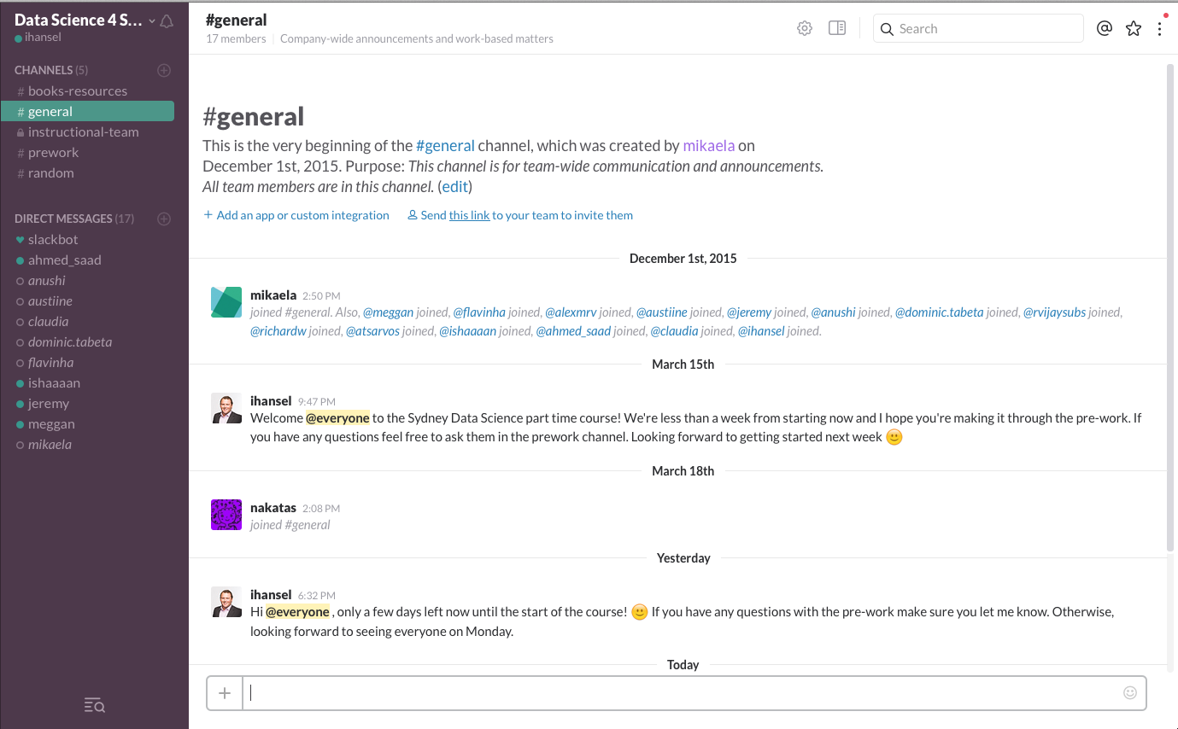

Slide 20
LAB
Create a Jupyter notebook
Confirm you are running python2, not python3
Write a “Hello World” notebook

Slide 21
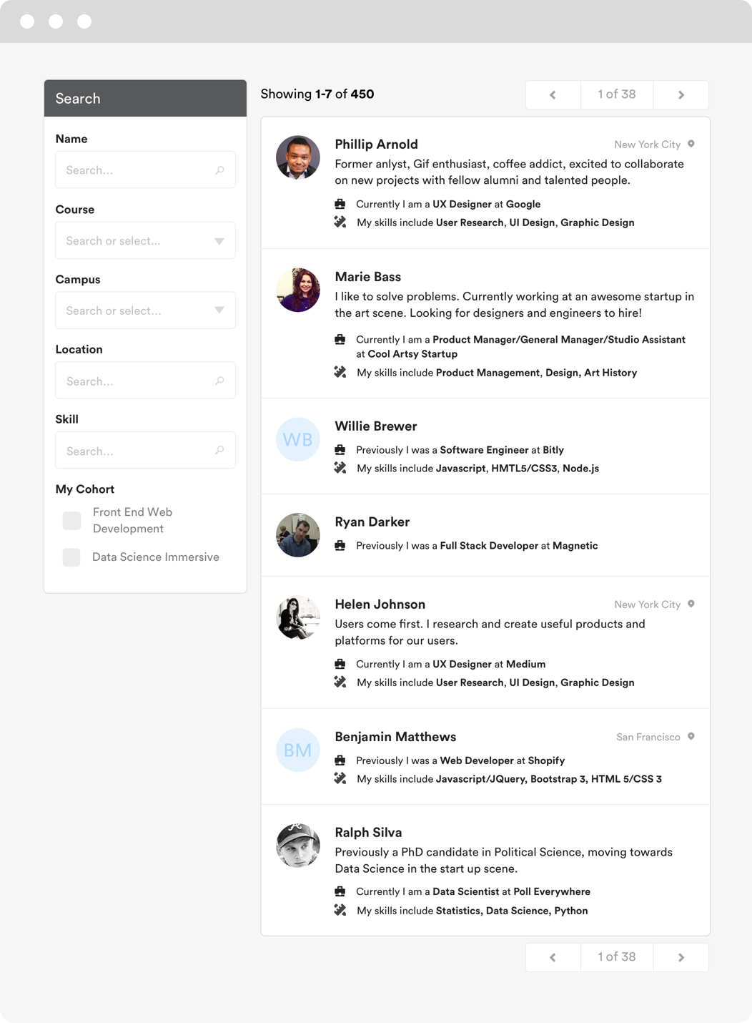

GA Directory
The GA Directory is a place for students, alumni and instructors to connect.
Find your classmates
Reach out to alumni and instructors
Hire talent based on skills and experience
directory.generalassemb.ly

Slide 22
Readings
Data Science Handbook (http://www.thedatasciencehandbook.com/)
DATA SCIENCE - Week 1 Day 1
16

Slide 23
Optional Reading
Codecademy Python course An Introduction to Statistical Learning
Python for Data Analysis
Learn Python the Hard Way
Command Line Crash Course
Khan Academy – Probability
DATA SCIENCE - Week 1 Day 1
17

